Slide 1
Group 3

Slide 2
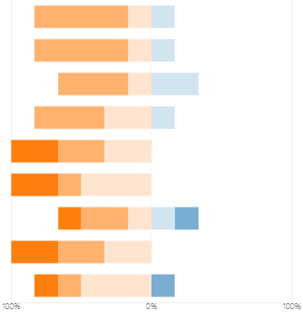
Mola Ayenew
Friendly and has individual contribution outside meetings. But I think he is a little busy so not always show up at group meetings.
very good for listening
1. Physical and psychological presence.
2. Contributing in meetings
3 Listening & including in meetings
4. Connecting and integrating in meetings
5a Individual contribution outside meetings – delivery
5b. Individual contribution outside meetings – quality and relevance
6. Proactive behavior and initiative
7. Respect
8. Differences and conflicts
Excellent Good Fair / ok Needs to improve Unacceptable MIssing

Slide 3
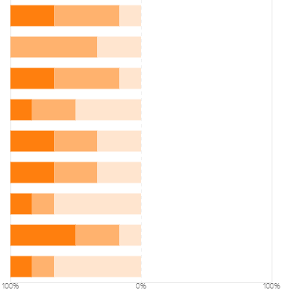
Tommy Ernsund
Always show up at meetings and always come up new ideas and find problems of our system, very logic, can give suggestions from different perspective. Not very active in group meeting, but I think its about personality..
He has good respect for all of us
although dont talk much, you do have much contribution for meeting
1. Physical and psychological presence.
2. Contributing in meetings
3 Listening & including in meetings
4. Connecting and integrating in meetings
5a Individual contribution outside meetings – delivery
5b. Individual contribution outside meetings – quality and relevance
6. Proactive behavior and initiative
7. Respect
8. Differences and conflicts
Excellent Good Fair / ok Needs to improve Unacceptable MIssing

Slide 4
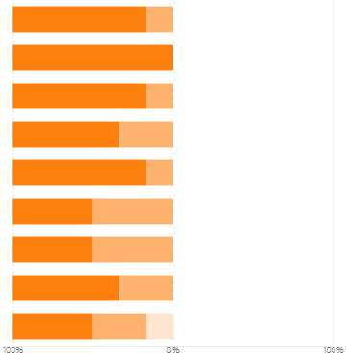
Pouya Faramarzi
every time you can organize a meeting and summerize the main points of the meeting, and often help the team members with their work..Its really great
The Team leader. Most proactive in the meetings, talks to everyone with respect and schedules meetings for everyone.
He has an excellent contribution in every meeting and out side meeting
Had down lots of work outside the meeting, like fix problems of our Latex format(it takes long time), review our assignment. Always answered others questions in meetings, very active and help solving others problems. Addresses task and norm differences and conflicts directly and constructively and helps to manage/resolve them, even if they do not involve himself. He just like our group leader.
1. Physical and psychological presence.
2. Contributing in meetings
3 Listening & including in meetings
4. Connecting and integrating in meetings
5a Individual contribution outside meetings – delivery
5b. Individual contribution outside meetings – quality and relevance
6. Proactive behavior and initiative
7. Respect
8. Differences and conflicts
Excellent Good Fair / ok Needs to improve Unacceptable MIssing

Slide 5
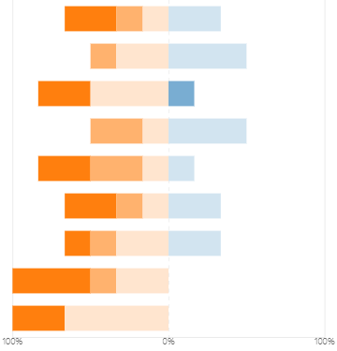
Wei Guo
Concerned about our project and always listen to our meetings carefully, doing individual contribution outside meetings,Respect to others. But she is not that active in meetings.
Doesn't say much in meetings but seems to be trying to improve
1. Physical and psychological presence.
2. Contributing in meetings
3 Listening & including in meetings
4. Connecting and integrating in meetings
5a Individual contribution outside meetings – delivery
5b. Individual contribution outside meetings – quality and relevance
6. Proactive behavior and initiative
7. Respect
8. Differences and conflicts
Excellent Good Fair / ok Needs to improve Unacceptable MIssing

Slide 6
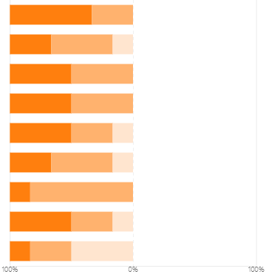
Sisi Lai
Very active in the meeting and do much work individually
Makes the most effort to communicate in meetings despite having poor english speaking skills
Always show up at meetings, show respect to others, contribution in meetings and outside the meetings. Acknowledges task and norm differences and conflicts and stays engaged with them. Not always encourage others to contribute....need to fix it
1. Physical and psychological presence.
2. Contributing in meetings
3 Listening & including in meetings
4. Connecting and integrating in meetings
5a Individual contribution outside meetings – delivery
5b. Individual contribution outside meetings – quality and relevance
6. Proactive behavior and initiative
7. Respect
8. Differences and conflicts
Excellent Good Fair / ok Needs to improve Unacceptable MIssing

Slide 7
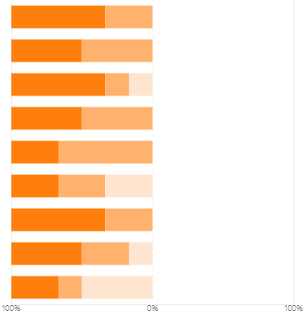
Abinav Prasad
Have many contributions in the meetings and very active
Very active at the meetings and contribute different ideas about system. Always answering others questions in meetings. Very polite and respect to others, communicate with different questions, not only about our group work, but also about daily life. It enhance our group connection. But he is speaking kind of fast that I cannot grasp him all and a little busy at sometimes so not always show up at meetings.
Has done his part well for R1.
1. Physical and psychological presence.
2. Contributing in meetings
3 Listening & including in meetings
4. Connecting and integrating in meetings
5a Individual contribution outside meetings – delivery
5b. Individual contribution outside meetings – quality and relevance
6. Proactive behavior and initiative
7. Respect
8. Differences and conflicts
Excellent Good Fair / ok Needs to improve Unacceptable MIssing

